Slide 1
Junior CCC Prep – J3
By Hussain M

Slide 2
What We Will Learn
Arrays
Buffered reader
For Loops

Slide 3
Arrays
Group of variables (called elements) that have values with same type
Can be thought of table of values
Elements
Data within the array
Index
Position of element in an array
must be of integer type

Slide 4
Declaring Arrays
To declare arrays, 2 things must happen:
Array needs to be declared:
Array needs to be created:
Value in square brackets are number of elements
After array is created, values are not known and must be initialized

Slide 5
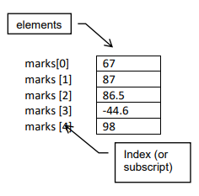
Array Example
Array on the right can be declared, created and initialized at the same time:
Elements are marks themselves
Indices of array are 0-4 and are always integers
∴ marks[2] = 86.5
marks[4] = 98
marks[7] = does not exist. (results in “index out of bonds” error)

Slide 6
Buffered Reader
Another way of inputting into Java
Involves few more lines of code than scanner input
Faster than scanner input
Higher level problems prefer buffered reader
Works with older versions of java

Slide 7
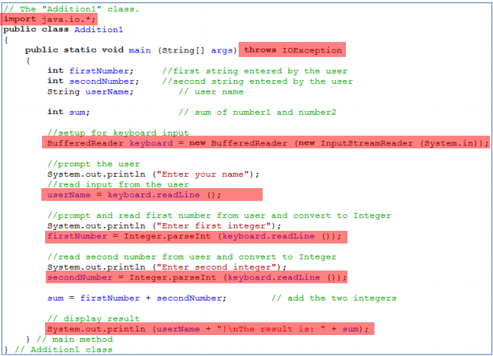
Changes Using Buffered Reader
Import java.io package instead of java.util
Setup Main to handle errors
Setup keyboard input using
Collect the input using
Input may need to be parsed depending on type of variable collected
For ex:

Slide 8

For Loops
Used for repeating the same lines of code for a known amount of times
Syntax shown on the right
Declare variable, state condition, state increment
i++ is same as i = i + 1
This will print “i” 10 times

Slide 9
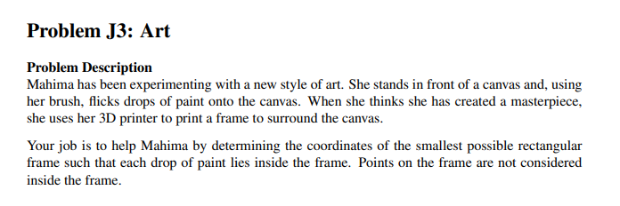
Example J3 Problem: Art

Slide 10
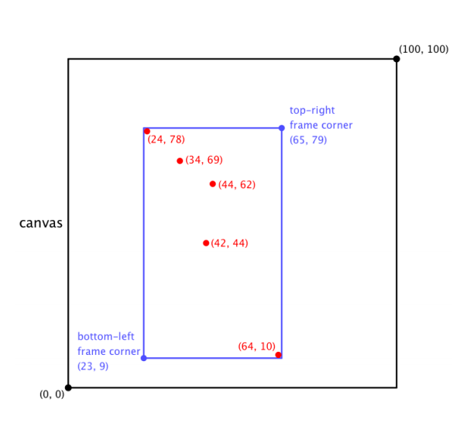
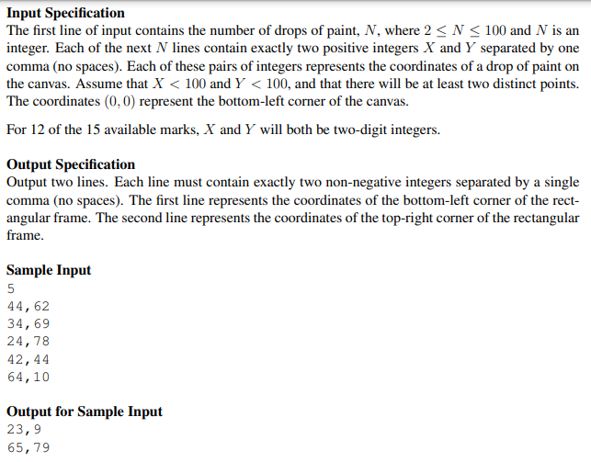
Understanding The Problem
5 random drops of paint (red dots)
Blue rectangle around all drops
Rectangle has 2 coordinates
First coordinate has x value one less than smallest x value and y value one less than smallest y value
Second coordinate has x value one larger than largest x value and y value one larger than largest y value
We must determine coordinates of rectangles

Slide 11
Break It Down To Smaller Problems

Slide 12
Sub problems
Collect input
Ensure to separate x and y coordinates
Retrieve smallest drop coordinate and largest drop coordinate
Sort drops in ascending order to do this
Output coordinates of rectangle

Slide 13
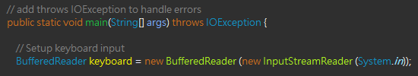
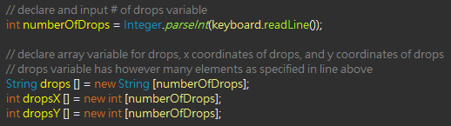
1) Collect The Input
Use buffered reader
Import java.io
Setup Main to handle errors
Setup keyboard input
Declare variables for…
Number of drops
Drops coordinates themselves
X coordinates of drops
Y coordinates of drops
Make these arrays

Slide 14
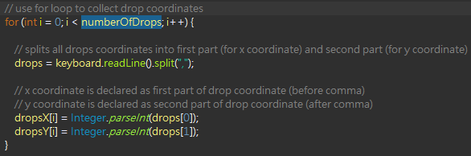
1) Collect The Input
Use for loop to collect drop coordinates and distribute X and Y coordinates
Condition in for loop is number of drops as we repeat input code for each drop of paint
Function “.split” splits the line read into an array of 2 different parts
First part is anything before comma (x-value of coordinate) and second part is anything after comma (y-value of coordinate)
Collect X and Y values using the following code:
0 | 1
44 | 62

Slide 15
2) Retrieve Smallest and Largest Drop
Now we have X values and Y values store in separate arrays, but not necessarily in ascending order.
We must sort these arrays in ascending order in order to get the smallest x and y values and largest x and y values
There are multiple ways to sort but we will use bubble sorting

Slide 16
Sorting
We will use bubble sorting (slowest but simplest method of sorting arrays)
Compare first element to the one next to it and the one next to that and so on, until you get to the end of the array
Repeat this step with every element
Involves nested for loops and if statement

Slide 17
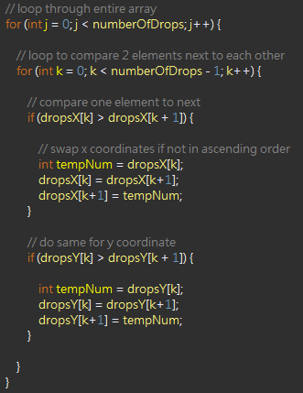
2) Retrieve Smallest and Largest Drop Using Bubble Sorting
First we loop through entire array
We want to do this process as many times as there are elements to ensure we compare every element
Then we loop again to compare two elements next to each other
Notice we loop 1 less than the total elements here
Lastly, we do our condition
if first element is bigger than next element, swap the elements

Slide 18
3) Output Coordinates of Rectangle
Now we have X values of coordinates and Y values of coordinates separated into specific arrays both arranged in ascending order
*Remember: Bottom left coordinate of rectangle has one less than the smallest X and Y values of drops and top right coordinate has one more than largest X and Y values.

Slide 19
3) Output Coordinates of Rectangle
Since we arranged the arrays in ascending order…
Index | X | Y
0 | 24 | 10
1 | 34 | 44
2 | 42 | 62
3 | 44 | 69
4 | 64 | 78

Slide 20
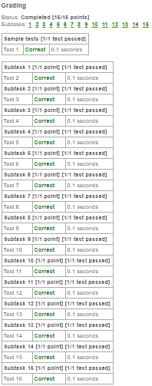
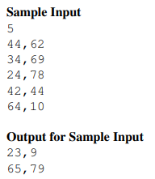
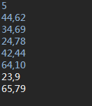
Test Your Solution

Slide 21
